Slide 1


SAVEETHA SCHOOL OF ENGINEERING DEPARTMENT OF ECE Drainage Monitoring System Using IoT
Name : Sidhartha .T
Reg no : 191312149
Dept : ECE
Year : IV
Mentor:-
Name : B.Bhuvaneswari (Asst Prof)
Dept : ECE

Slide 2
OUTLINE
Objective
Block Diagram
Implementation(software and hardware)
Coding
Graph
Partial Output
References

Slide 3

Objective:
The main objective of this system is to analyse the drainage monitoring system through cloud and sends an alert to the corresponding Municipal authorities.

Slide 4
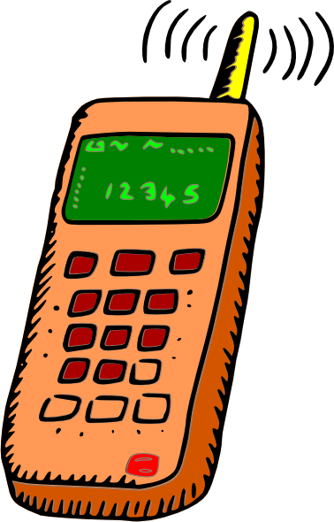
Block Diagram
cloud
Data import

Slide 5
Implementation
Data base management system
Contains general data obtained from various time instances with which the data received from the circuits will be compared and generate the alerts.

Slide 6
SOFTWARE USED :
Arduino
HARDWARE USED :
Galelio gen2
Wifi module
Gsm shield

Slide 7
Explanation
Alerts will be generated when the blockage starts developing
Time available to repair the blockage will be enough to prevent the drainage line from completely shutting down.
This technology can be used for all fluid carrying systems. (e.g. Water pipes, gas pipelines)

Slide 8
Program
void updateThingSpeak(String tsData)
{
if (client.connect(thingSpeakAddress, 80)) //https://www.arduino.cc/en/Reference/WiFiClientConnect
{
client.print("POST /update HTTP/1.1\n");
client.print("Host: api.thingspeak.com\n");
client.print("Connection: close\n");
client.print("X-THINGSPEAKAPIKEY: "+writeAPIKey+"\n");
client.print("Content-Type: application/x-www-form-urlencoded\n");
client.print("Content-Length: ");
client.print(tsData.length());
client.print("\n\n");
client.print(tsData);
else
{
failedCounter++;
Serial.println("Connection to ThingSpeak Failed ("+String(failedCounter, DEC)+")");
Serial.println();
lastConnectionTime = millis();
}
//lastConnectionTime = 0;
}

Slide 9
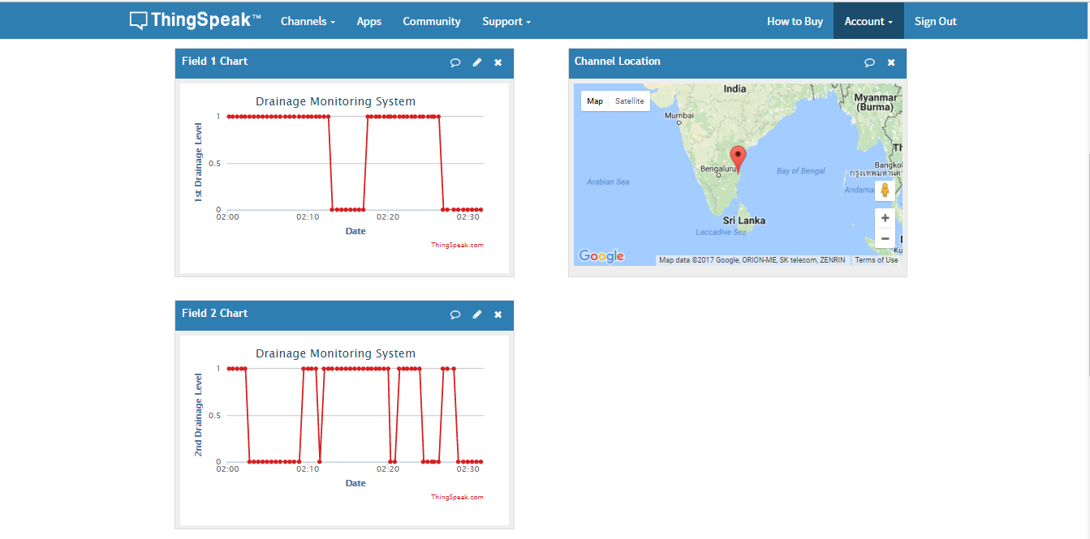
Output

Slide 10
Conclusion
Thus the clogs in the drainage gets identified using these circuit. And the concerned authorities notified from the cloud and GSM.

Slide 11
References
[1] Lazarescu, M.T., "Design of a WSN Platform for Long-Term Environmental Monitoring for IoT Applications," Emerging and Selected Topics in Circuits and Systems, IEEE Journal on , vol.3, no.1, pp.45,54, March 2013.
[2] Kelly, S.D.T.; Suryadevara, N.K.; Mukhopadhyay, S.C., "Towards the Implementation of IoT for Environmental Condition Monitoring in Homes," Sensors Journal, IEEE, vol.13, no.10, pp.3846,3853, Oct. 2013.
[3] Romer, K.; Mattern, F., "The design space of wireless sensor networks," Wireless Communications, IEEE , vol.11, no.6, pp.54,61, Dec. 2004
[4] M. Kuorilehto, M. Kohvakka, J. Suhonen, P. Hmlinen, M. Hnnikinen, and T. D. Hmlinen, Ultra-Low Energy Wireless Sensor Networks in Practice. New York: Wiley, 2007.
[5] K. Romer and F. Mattern, “The design space of wireless sensor networks,” IEEE Wireless Comm., vol. 11, no. 6, pp. 54–61, Dec. 2004.

Slide 12
THANK YOU!!!

